Slide 1
“Heartland Escapes” Data Security Proposal
Aidan Polivka

Slide 2
Agenda
Regulatory Requirements
Sarbanes-Oxley
PCI DSS
Policies
Controls
Access Controls
Data Security
Network Security
Topography
Intrusion Detection & Prevention
Security Assessments
Risk Level Analysis
Document Format
Risk Mitigation Options

Slide 3
Regulatory Requirements: Sarbanes-Oxley Act
Section 404 – Management Assessment of Internal Controls.
Section 404(b) - Auditor's Attestation.
Section 409 - Real-Time Issuer Disclosures.
Section 802 - Criminal Penalties for Altering Documents.
Audit Committee Independence (Various Sections).
Notes:
Section 404 – Management Assessment of Internal Controls. Heartland Escapes must be able to assess and report on the effectiveness of their internal controls over financial reporting. The effectiveness of information security controls also falls within this category.
Section 404(b) - Auditor's Attestation. Auditors of Heartland Escapes system must be able to attest to the effectiveness of Heartland Escapes security controls. Meaning the auditors will need access to the internals of Heartland Escapes system and be able to ensure that Heartland Escapes falls within data security and integrity compliance.
Section 409 - Real-Time Issuer Disclosures. Heartland Escapes must be able to communicate changes in the state of their financial condition securely and in real-time. This will require secure communication of financial information.
Section 802 - Criminal Penalties for Altering Documents. Any data tampering (internally or externally) can result in criminal penalties directed at Heartland Escapes. Production data must be highly secured, and a data retention plan should be in place that follows compliance guidelines.
Audit Committee Independence (Various Sections). The Audit committee must be a third party that is independent from Heartland Escapes. (Oxley, 2002)

Slide 4
Regulatory Requirements: Payment Card Industry Data Security Standard (PCI DSS)
Install and maintain a firewall system to protect cardholder data.
Avoid vendor-supplied defaults for system passwords and other security parameters.
Protect stored cardholder data.
Encrypt transmission of cardholder data on open, public networks.
Protect all systems against malware and update anti-virus software or programs.
Develop and maintain secure systems and applications.
Restrict access to cardholder data by business need to know.
Identify and authenticate access to system components.
Restrict physical access to cardholder data.
Track and monitor access to network resources and cardholder data.
Regularly test security systems and processes.
Maintain an information security policy which addresses information security for all personnel.

Slide 5
Security Policies
Data Encryption in Transit and at Rest
Data should be encrypted while it’s being sent over the wire, and while it’s dormant in Heartland Escapes databases
Real time auditing and log monitoring
To ensure data security, all activity to and from the Heartland Escapes should be monitored.
Least Privilege Data Access
Any access to data should be limited to individuals who need to see or transfer such data.
Regular Internal and External System Auditing
Heartland Escapes system should be audited internally and externally, looking for areas to improve and maintaining up to date with evolution in best practices.
Internal Training
Individuals working for or with Heartland Escapes should be subject to training programs for information security and suspicious behavior reporting.

Slide 6
Policy Implementations
Any transmission of Heartland Escapes Data will be performed over secure network protocols (https, TLS, OpenVPN)
All data will be encrypted at rest
PII will be stored as encrypted text (SSN, Account Numbers, Dates of Birth, etc)
PII and sensitive data will not be logged directly. (records will be identifiable by database primary keys)
All logs (network, application, and database) will be monitored by secure and vetted software. Anomalies and suspicious behavior will be flagged as it’s detected by monitoring software.
An individual or group of individuals will be available 24/7 to respond to flagged suspicious behavior within network logs.
Role Based Access Controls will be implemented to give individuals authorization to only the data and segments of the system they need to access
No individual will have direct access to production SQL scripting or data
Just-In-Time controls will be implemented so that data is only accessible when needed.

Slide 7
Policy Implementations: Continued
Individuals performing data requests will need authentication using up to date authentication standards (currently OAuth 2.0)
Passwords will be rotated every 3 months, the new password must differ from the past 12 passwords, and each password must be at least 16 characters, with at least 1 capital letter, 2 digits, and 2 special characters.
Internal information security specialists will stay up to date with changing system and data security standards. Our system will be audited by these individuals quarterly to ensure that we are within a tolerable threshold of security best practices.
SOX auditors will be granted access to systems and infrastructure during scheduled audits.
Regular internal vulnerability assessments will be conducted, and regular external penetration tests will be conducted. Regular phishing simulations will also be conducted.
Training will be conducted regularly and repeatedly over information security (phishing awareness, USB security, etc.)
“See something, say something” training will be implemented to ensure employees are holding each other accountable, and so they know that whistle blowers will be protected by the company.
Tailored training to security roles (RBAC) will be created and conducted. Individuals with elevated access and responsibilities should be trained accordingly.
Employee reporting procedures will be well defined, and easily accessible

Slide 8

Access Controls
Azure Active Directory & Managed Instances
Role Based Access Control
Auth 2.0: Single Sign On Authentication
Azure VPN Integration
Notes:
We will use Azure Active Directory and Auth 2.0 for Single Sign On Authentication. Each Azure component (App Service and Database) will utilize Azure Managed Instances for their app service account. This will allow for the service to access the Azure Key Vault without needing to directly set Key Vault values from environment settings/variables. This grants us additional layers of security for our applications. Role Based Access Controls will be in place for User and App Service Accounts. Not all users will need read/write access of databases, and neither will all services. Roles with sensitive access will be doled out with significant discretion.

Slide 9
Data Security
At Rest
Data in storage should not be in clear text
PII should be stored as cypher-text
Logging of data transactions should be data discrete
In Transit
Data in motion is by nature more vulnerable to attack
PII should be transmitted as cypher-text, and decrypted by the requesting service
Logging of app service actions should be data discrete
All communication should be using https and TLS/SSL
There will be a single point of external access from the public website.

Slide 10
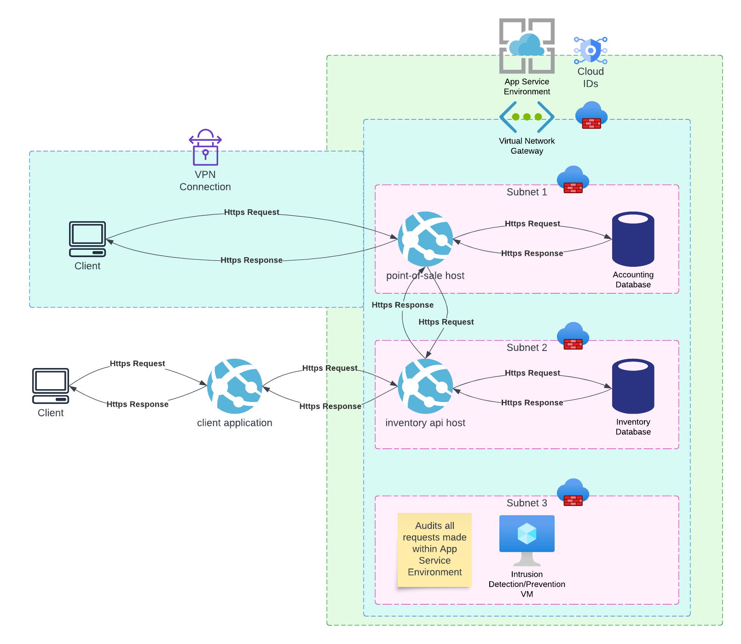
Network Topography
Notes:
* Break down the VPN, Vnet, and Subnet structures. Highlight segmentation of Inventory & POS systems. Make quick note of IDPS VM, more to note on next slide.

Slide 11
Intrusion Detection & Prevention
Azure Firewall Premium: Wireless Intrusion Detection (IDPS)
TLS inspection of outbound traffic
signature based IDPS
URL filtering
Suricata: Wireless Intrusion Detection & Network Behavior Analysis (IDPS)
Signature-based analysis
Anomaly-based analysis
Configurable response protocols

Slide 12
Audits & Logging
App Service Environment
Allows for a central location to query logs within Heartland Escapes system
Allows for automatic flagging of suspicious logs
Will allow for auditing actions of individuals by Azure Active Directory account
Logging available within IDPS
Should be able to view all network traffic within ASE from Suricata

Slide 13
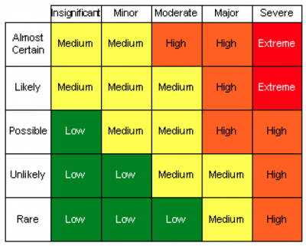
Security Assessments
Internal vertical and horizontal auditing of Heartland Escapes systems security will be required on a regular basis.
Risks will be scaled according to this risk analysis matrix

Slide 14
Security Assessments: Document Format
Risk assessment owner
Identification date
Progress status
Current risk level
Risk scenario
Proposed treatment plan(s)
Residual risk level (what is the risk level after each potential treatment)
Existing security controls

Slide 15
Security Assessments: Risk Mitigation Options
Avoidance. At this point, avoidance is an option we’ll seldom suggest to Heartland Escapes, because their goal is to get our input on their modernization effort. However, this scenario is when the technology that poses the risk isn’t valuable enough to fix. If it’s deprecated, or unused, then the proposal could be for Heartland Escapes to discontinue use of the technology.
Transfer. This may be a commonly proposed option. Rather than suggesting code changes, we may propose that Heartland Escapes takes advantage of third-party software to mitigate an identified risk. For example, Azure (which happens to be the platform Heartland Escapes is migrating to) has tools for protecting against DDoS attacks. If it’s found that Heartland Escapes’ public website is susceptible to such attacks, it may be more worthwhile to suggest utilizing Azure’s technologies over making code changes. Or we could prevent this attack from multiple angles by both transferring the mitigation effort and reducing the risk ourselves with code changes like rate-limiting requests.
Reduce. The third option is to reduce the risk by making explicit changes. Carrying forward the example of a DDoS attack, we could choose to reduce the ability of bad actors to perform such an attack by rate limiting requests from IP addresses to the public website. (Cobb, 2024)
Acceptance. The final option is to accept the risk. The only scenario in which we would ever suggest accepting a risk is if it’s been determined that the risk threat is minuscule, and the cost to mitigate the risk through another means is more expensive than it’s worth. Accepting a risk is a risk within itself and should be suggested with caution.

